Slide 1

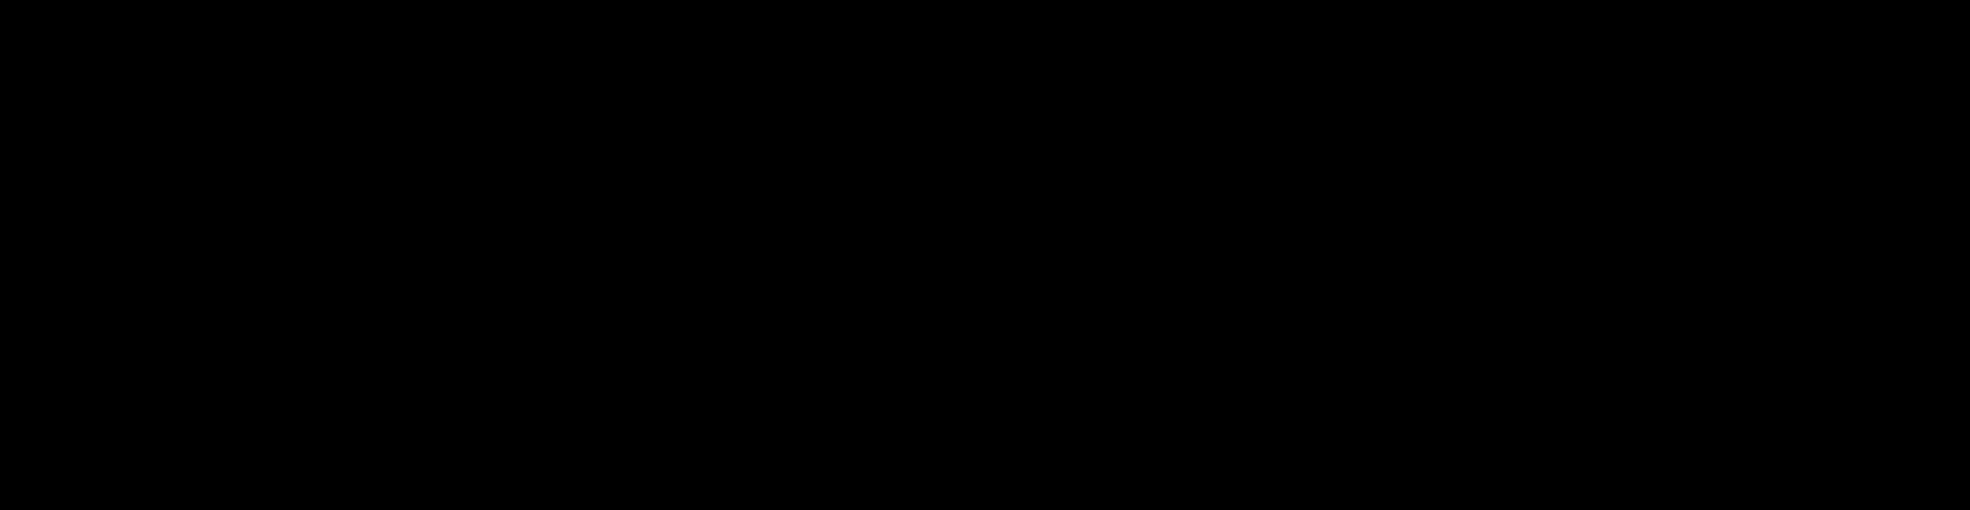


SUPPORT VECTOR MACHINE
Presented by:
Hassan Fareed
Ali Najam
Aqsa Farooq
Arbab hussain

Slide 2
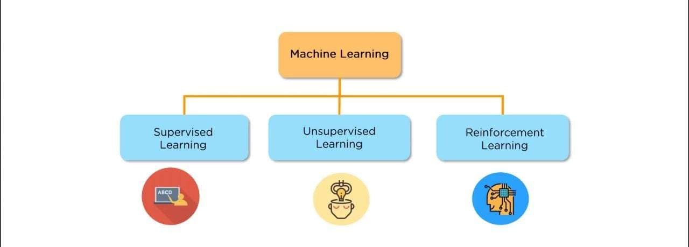

Slide 3
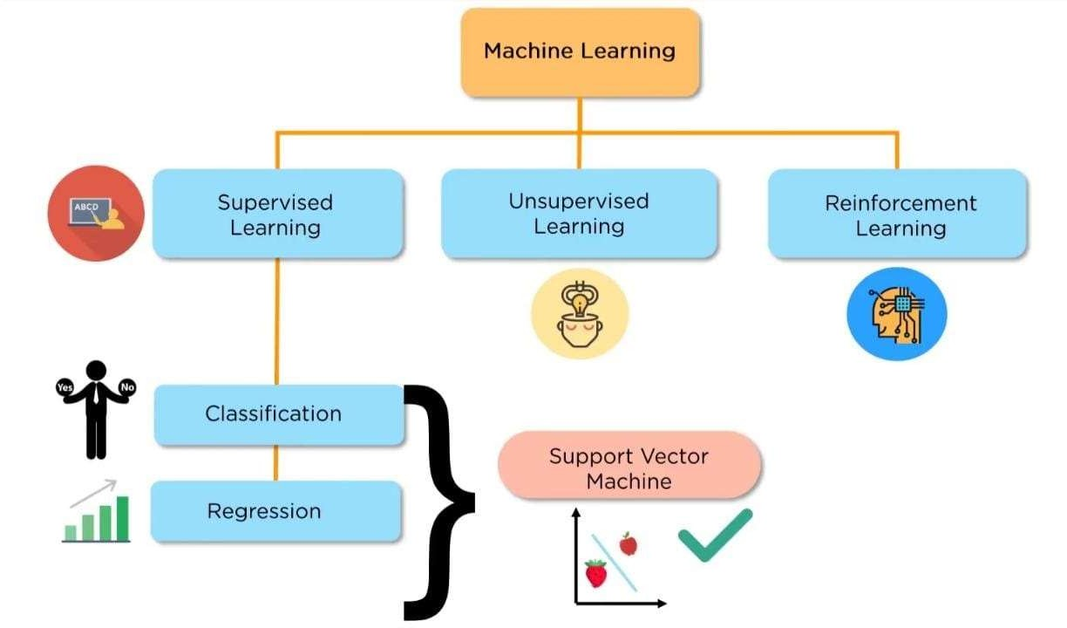

Slide 4
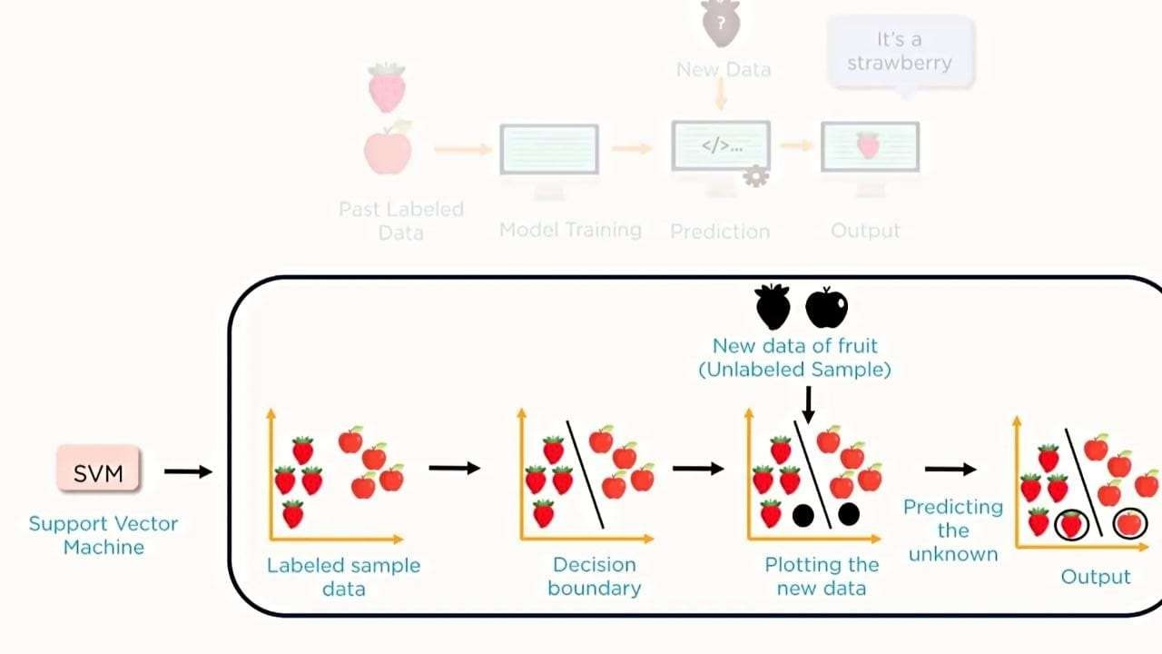

Slide 5
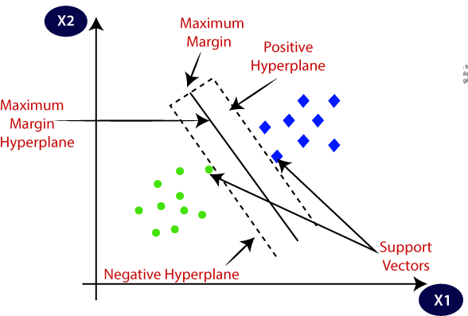
UNDERSTANDING SVM ?
Support Vector Machine or SVM is one of the most popular Supervised Learning algorithms, which is used for Classification as well as Regression problems. However, primarily, it is used for Classification problems in Machine Learning.
The goal of the SVM algorithm is to create the best line or decision boundary that can segregate n-dimensional space into classes so that we can easily put the new data point in the correct category in the future. This best decision boundary is called a hyperplane.
SVM chooses the extreme points/vectors that help in creating the hyperplane. These extreme cases are called as support vectors, and hence algorithm is termed as Support Vector Machine. Consider the below diagram in which there are two different categories that are classified using a decision boundary or hyperplane:

Slide 6
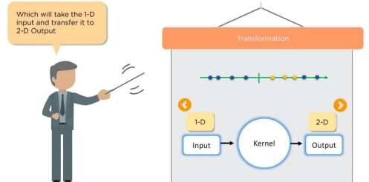
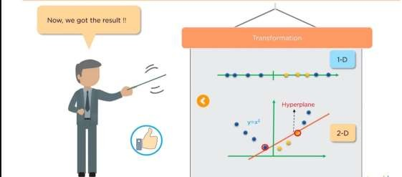
NOT LINEARLY SEPARABLE
1-D to 2-D

Slide 7
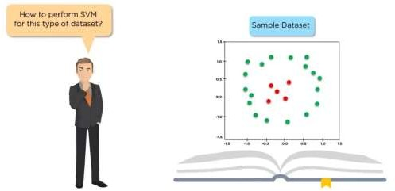
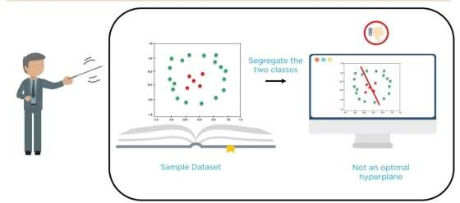
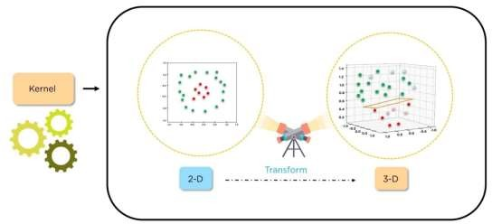
2-D to 3-D

Slide 8

Variant of SVM
C-SVM (C-Support Vector Machine)
Nu-SVM (Nu-Support Vector Machine)

Slide 9
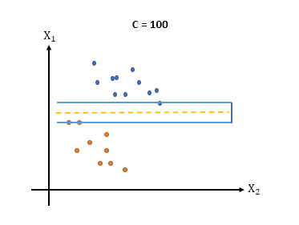
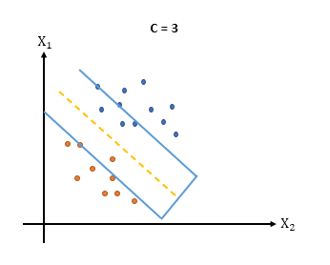
C-SVM (C-Support Vector Machine)
In C-SVM, the parameter "C" is used to control the trade-off between having a smooth decision boundary and classifying the training points correctly.
Smaller C value results in a softer margin and allows more training points to be misclassified
Larger C value puts more emphasis on classifying all training points correctly, potentially leading to a narrower margin

Slide 10
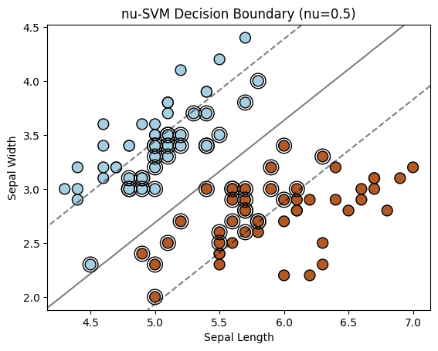
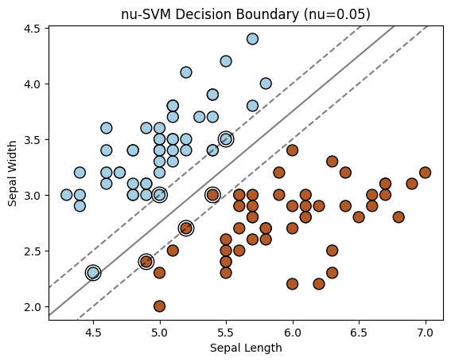
Nu-SVM (Nu-Support Vector Machine)
In Nu-SVM, the parameter "Nu" is used to controls the trade-off between having a smooth decision boundary and classifying data points correctly.

Slide 11

Which One is the Best
Which Algorithm Is better
Better algorithm depends on the dataset used and the accuracy and low complexity we get from the that model.
Let us look into the code and then identify which algorithm is better in performance.

Slide 12


